Slide 1
Introduction to Ethics
By: Dr. T.M.Venthan

Slide 2
What is Ethics
moral principles that govern a person's behaviour or the conducting of an activity
ethics is a branch of philosophy that is concerned with human conduct, more specifically the behaviour of individuals in society.
What is a Code of Ethics?
A code of ethics refers to a set of guiding principles that help professionals and companies conduct business with honesty and integrity.

Slide 3
What is Morality?
Morality is a set of values, beliefs, and principles that guide an individual’s behavior and decisions. It is a code of conduct that is commonly accepted in a particular society or culture.
Example of Morality
Morality is the set of standards that dictate what is right and wrong in terms of behavior and beliefs. Examples of morality include being honest, treating others with respect, helping those in need, and adhering to laws and social norms.

Slide 4
Difference Between Ethics and Morals
To put it simply, ethics are the principles that govern how people should interact with each other and their environment. Morals, on the other hand, are individual values that dictate how we behave and make decisions.
What are Environmental Ethics?
Environmental ethics is a branch of ethical thought that focuses on the relationship between humans and their natural environment.

Slide 5
Examples of Environmental Ethics
One example of environmental ethics in action is using renewable energy sources. Renewable energy sources are sources of energy that are naturally replenished and can be used without depleting natural resources. Examples of renewable energy sources include solar, wind, and hydropower. Renewable energy sources are seen as an ethical choice, as they do not cause pollution or deplete finite resources.

Slide 6
“Code of Ethics” and “Code of Conduct”
Code of Ethics and Code of Conduct are both common terms used in the business world and share many of the same characteristics. They may also be used interchangeably by some and/or organizations, which can often confuse when determining what the two mean and how they differ from one another.
Code of Ethics:
A code of ethics provides an organization with a set of principles that describe its behaviours. Codes typically include issues like confidentiality, discrimination, conflict of interest, harassment, and whistleblowing.

Slide 7
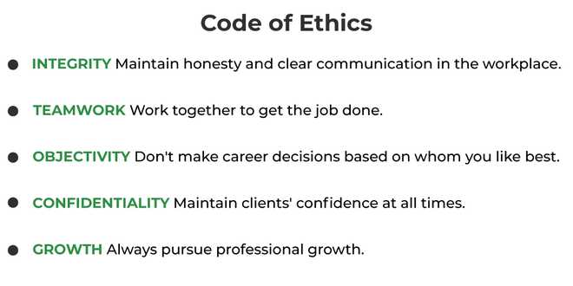

Slide 8
Code of Conduct:
A Code of Conduct is a written set of rules and standards that every employee must obey. It tells people what to do, as well as what not to do, in the workplace. For example, most codes of conduct prohibit sexual harassment and discrimination. Codes of conduct may also contain provisions for respecting confidential information or company property.

Slide 9
Differences Between Code of Ethics and Code of Conduct:
The Code of Conduct is very general, while the Code of Ethics is more in-depth.
A Code of Conduct usually only applies to those within the company, while a Code of Ethics is usually required for those working on behalf of the company.
A Code of Conduct might dictate how employees should dress, while a Code of Ethics typically addresses ethical decisions made within the company.
A Code of Conduct will be limited to one profession or industry, but a Code of Ethics may apply across many different industries.
Codes of Conduct are typically not enforced by law, but Codes of Ethics are often subject to legal penalties for violation.
Many companies do not have a Code of Conduct, but most do have a Code of Ethics.

Slide 10
Violations of a Code of Conduct are punishable by firing or other means, while violations of a Code of Ethics can result in fines or jail time.
Codes of Conduct are intended to protect the interests of an organization, while Codes of Ethics exist to maintain public trust.
There is no set punishment for breaking a Code of Conduct; however, violating a Code of Ethics can lead to criminal charges.
An organization without either a Code of Conduct or a Code of Ethics runs the risk of facing lawsuits for illegal activity.

Slide 11
Profession
A profession is a vocation founded upon specialized educational training, the purpose of which is to supply disinterested objective counsel and service to others, for a direct and definite compensation, wholly apart from expectation of other business gain. profession is a specialized occupation or career that requires specific training, education, and expertise.
Professional responsibility is a set of duties within the concept of professional ethics for those who exercise a unique set of knowledge and skill as professionals. professional is someone who is skilled, knowledgeable, and conducts themselves with integrity in their chosen field or occupation.
Professionalism is the conduct, behavior and attitude of someone in a work or business environment.

Slide 12
Professional
A professional is a member of a profession or any person who earns their living from a specified professional activity. The term also describes the standards of education and training that prepare members of the profession with the particular knowledge and skills necessary to perform their specific role within that profession.
The main difference between Professional and Profession is that the Professional is a person who is paid to undertake a specialized set of tasks and to complete them for a fee and Profession is a vocation founded upon specialized educational training.

Slide 13
Professional Practice
Professional Practice is a term used to describe activities which will help you apply your knowledge to your industry, job role or workplace.
Professional practice: is where a student is required to extend knowledge and skills within a practical environment.

